Slide 1
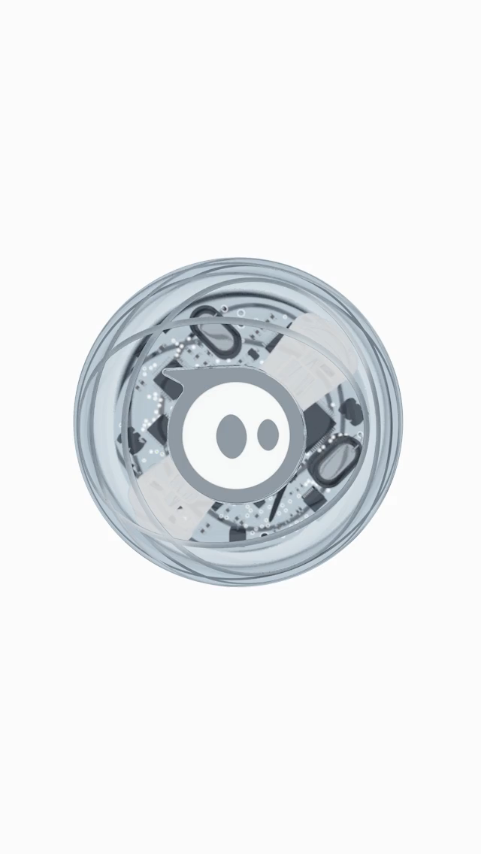
SPHERO
Async and await
Presented by
Ankit Prakash
Rahul Reddy Dayam
Venkat Akhil Pendem
Ramesh Nutulapathi
Keerthi Sree Kukunoor

Slide 2






MEET THE TEAM
Ankit Prakash
Rahul Reddy Dayam
Ramesh Nutulapathi
Venkat Akhil Pendem
Keerthi Sree Kukunoor

Slide 3
AGENDA
In this tutorial you will be able to learn:
What is a Sphero? Different types of sphero available in the market.
Some of the important features of sphero.
Getting started with sphero and about sphero edu app.
Different ways to code this little beast.
What is ASYNC and AWAIT function?
The role of ASYNC and AWAIT function in coding sphero.
To create a small fun game using sphero.

Slide 4
What is Sphero?
As name itself specifies it is a spherical robot designed by Sphero.
It’s design is packed with a little Gyroscope, accelerometer and LED lights.
Initially in 2011 inventors, Lan Bernstein and Adam Wilson prototyped for Sphero.
It is considered to be the world’s first robotic ball that can be controlled with a tilt, touch, or swing from Smartphone or Tablet.
It can run through Android, IOS, windows and can be connected to phone via bluetooth.
We can drive Sphero, play tabletop and multi player games, hold it in our hands and can use it as controller for on-screen gameplay, learn basic programming, and even explore augumented reality.
It’s programmed in JAVA SCRIPT.

Slide 5
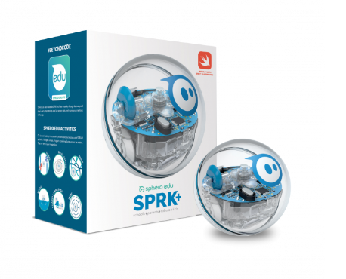
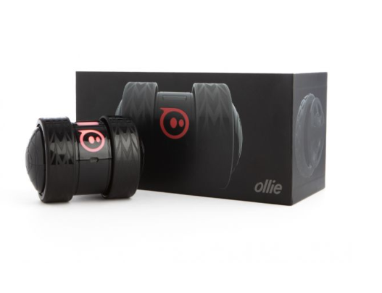
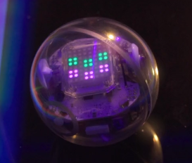
Different types of Spheros available:
SPRK+
Darkside Ollie
Bolt

Slide 6
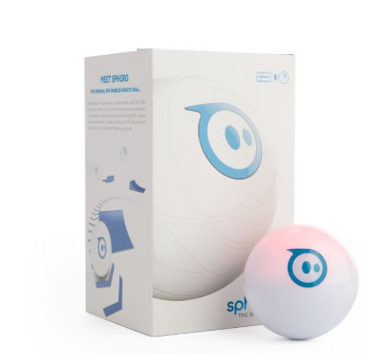
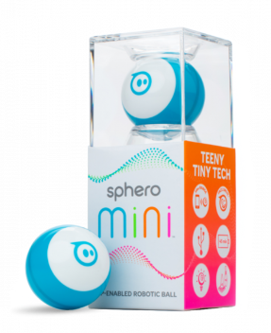
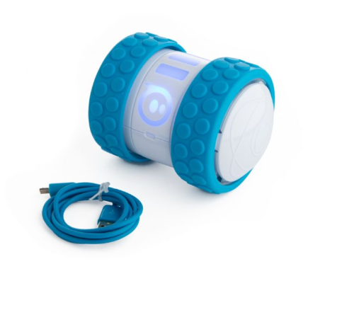
Sphero 2.0
MINI
Ollie

Slide 7
Important features of sphero
Control System & Motors
Lights
SENSORS
IMU(Inertial Measurement Unit)
Accelerometer and Gyrometer
Collision Detection
Locator
Bluetooth

Slide 8
Getting started with sphero
Download sphero edu app . https://www.microsoft.com/en-us/p/sphero-edu/9n2796r62xlz?rtc=1&activetab=pivot:overviewtab
Connect your sphero to device using USB.
Go to drive and choose your sphero to connect.

Slide 9
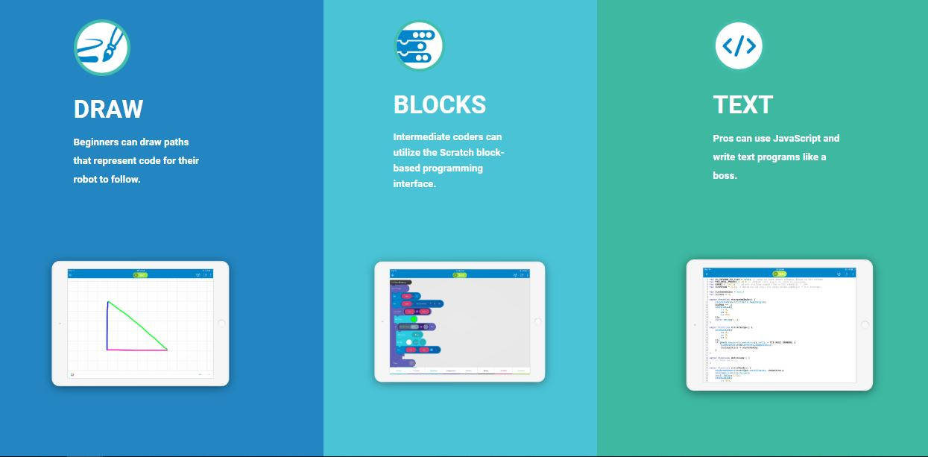
Program 3 Ways the Sphero Edu app allows you to program your robot 3 different ways.
Notes:
Different Ways to code;
By Ramesh

Slide 10
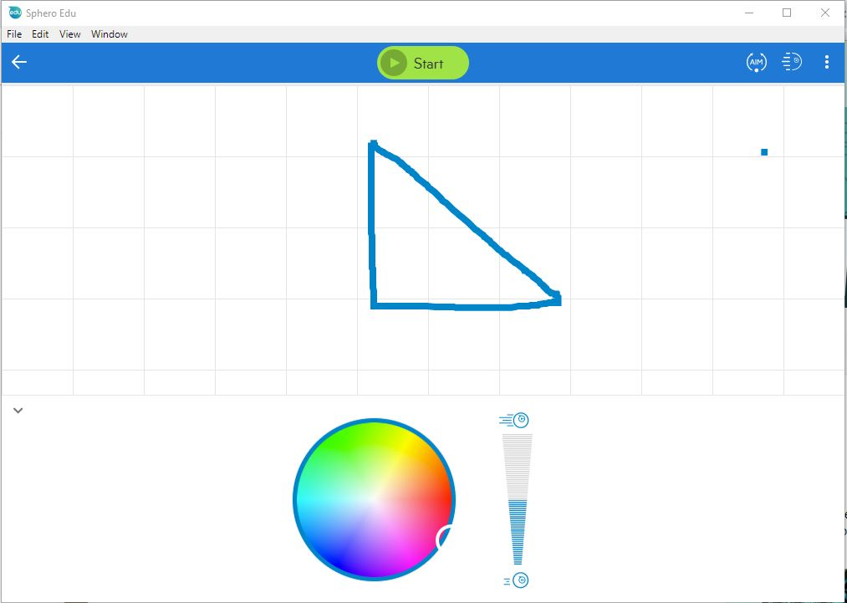
Draw Programming:
This is the simpler method of programming. Users draw lines to program their robot.
Notes:
Different Ways to code;
By Ramesh

Slide 11
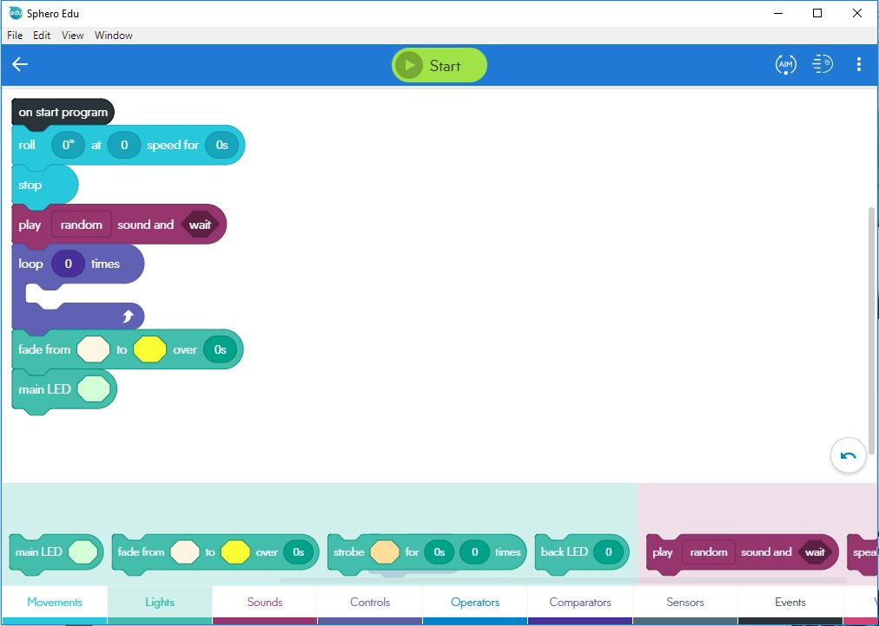
Block Programming: Block-based drag and drop interface. You can view the JavaScript text code behind a blocks program.

Slide 12
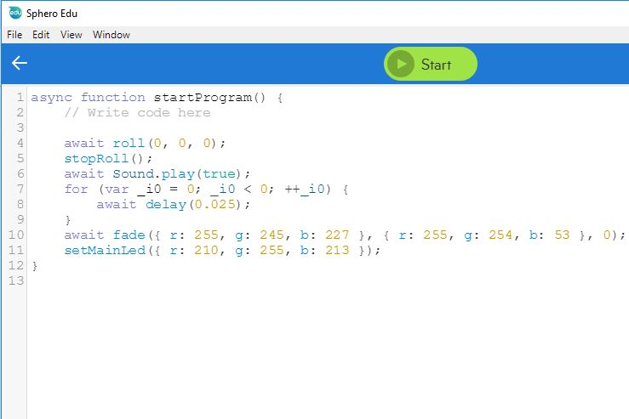
Text Programming: Can program with a text editor. All text coding is done using JavaScript.

Slide 13
ASYNC & AWAIT

Slide 14
Before jumping directly to Async, consider this
Suppose if we want to do a task after completing a different task or if we want to perform certain number of tasks one after the other and not simultaneously.
How will you achieve this without using Async function?

Slide 15
CALLBACKS
setTimeout(function() {
console.log('This runs after 5 seconds');
}, 5000);
console.log('This runs first');
But if we want to do things sequentially that is one after another
doThingOne(function() {
doThingTwo(function() {
doThingThree(function() {
doThingFour(function() {
// What the hell?
});
});
});
});
This is called Callback hell.

Slide 16
Promises
A Promise is an object which represents an asynchronous task that will eventually finish.

Slide 17
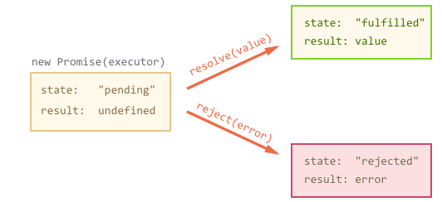
They look like this when used
let promise = new Promise(function(resolve, reject) {
// the function is executed automatically when the promise is constructed
// after 1 second signal that the job is done with the result "done!"
setTimeout(() => resolve("done!"), 1000);
});
Notes:
Imagine that you’re a top singer, and fans ask day and night for your upcoming single.
To get some relief, you promise to send it to them when it’s published. You give your fans a list to which they can subscribe for updates. They can fill in their email addresses, so that when the song becomes available, all subscribed parties instantly receive it. And even if something goes very wrong, say, if plans to publish the song are cancelled, they will still be notified.
Everyone is happy, because the people don’t crowd you any more, and fans, because they won’t miss the single.
This is a real-life analogy for things we often have in programming:
A “producing code” that does something and takes time. For instance, the code loads a remote script. That’s a “singer”.
A “consuming code” that wants the result of the “producing code” once it’s ready. Many functions may need that result. These are the “fans”.
A promise is a special JavaScript object that links the “producing code” and the “consuming code” together. In terms of our analogy: this is the “subscription list”. The “producing code” takes whatever time it needs to produce the promised result, and the “promise” makes that result available to all of the subscribed code when it’s ready.

Slide 18
Promises have some other very interesting properties, which allow them to be chained. Lets say we have other functions that return a Promise. We could do this:
buyCoffee()
.then(function() {
return drinkCoffee();
})
.then(function() {
return doWork();
})
.then(function() {
return getTired();
})
.then(function() {
return goToSleep();
})
.then(function() {
return wakeUp();
});

Slide 19
What is an Async function?
An asynchronous function is a function which operates asynchronously via the event loop, using an implicit Promise to return its result.
Or
Async functions are functions that return promises.

Slide 20
Example
// Some random async functions that deal with value
async function thingOne() { ... }
async function thingTwo(value) { ... }
async function thingThree(value) { ... }
async function doManyThings() {
var result = await thingOne();
var resultTwo = await thingTwo(result);
var finalResult = await thingThree(resultTwo);
return finalResult;
}
// Call doManyThings()

Slide 21
To keep in mind
• Async functions are declared by prepending the word async in their declaration
• Your code can be paused waiting for an Async Function with await.
• await returns whatever the async function returns when it is done.
• await can only be used inside an async function.

Slide 22
Lets see how async/await roughly translates into Promises
// Async/Await version
async function helloAsync() {
return "hello";
}
// Promises version
function helloAsync() {
return new Promise(function (resolve) {
resolve("hello");
});
}

Slide 23
FUN TIME

Slide 24
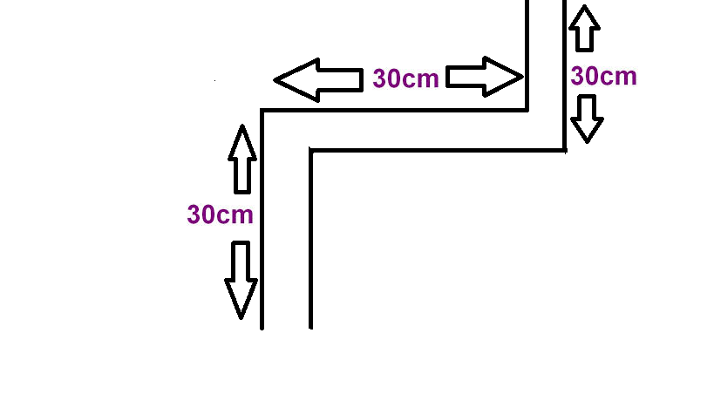
The Sphero Maze Path:

Slide 25
JavaScript code For the sphero path :
async function startProgram() {
setMainLed({ r: 111, g: 255, b: 24 });
await roll(0, 40, 2.6);
await delay(2);
await fade({ r: 57, g: 255, b: 2 }, { r: 255, g: 4, b: 21 }, 1);
await fade({ r: 255, g: 21, b: 73 }, { r: 75, g: 255, b: 23 }, 1);
await delay(3);
await roll(90, 40, 2.5);
await fade({ r: 49, g: 255, b: 19 }, { r: 255, g: 3, b: 31 }, 1);
await fade({ r: 255, g: 21, b: 73 }, { r: 52, g: 255, b: 3 }, 1);
await roll(0, 40, 2.5);
await speak('destination reached thank you ', true);
stopRoll();
}

Slide 26
References
https://developer.mozilla.org/en-US/docs/Web/JavaScript/Reference/Statements/async_function
https://developers.google.com/web/fundamentals/primers/promises
https://javascript.info/promise-basics
https://medium.com/@rafaelvidaurre?source=post_header_lockup

